Slide 1


Database Systems [Introduction to Database]

Slide 2



Data is a collection of a distinct small unit of information.
It can be used in a variety of forms like text,
numbers, media, bytes, etc.
It can be stored in pieces of paper or electronic memory, etc.
Word 'Data' is originated from the word 'datum'
that means 'single piece of information.’
It is plural of the word datum.
In computing, Data is information that can be translated into a form for efficient movement and processing.
Data is interchangeable.
What is Data?

Slide 3
A database is an organized collection of data, so that
it can be easily accessed and managed.
You can organize data into tables, rows, columns, and index it to make it easier to find relevant information.
Database handlers create a database in such a way that only one set of software program provides access of data to all the users.
The main purpose of the database is to operate a large amount of information by storing, retrieving, and managing data.
There are many dynamic websites on the World Wide Web nowadays which are handled through databases.
For example, a model that checks the availability of rooms in a hotel.
It is an example of a dynamic website that uses
a database.
What is Database?

Slide 4
There are many databases available like MySQL, Sybase, Oracle, MongoDB, Informix, PostgreSQL, SQL Server, etc.
Modern databases are managed by the DataBase Management System (DBMS).
SQL (Structured Query Language) is used to operate
on the data stored in a database.
SQL depends on relational algebra and tuple relational calculus.
What is Database?

Slide 5



Evolution of Databases
The database has completed more than 50 years of journey of its evolution from flat-file system to relational and objects relational systems.
It has gone through several generations.

Slide 6


1968 was the year when File-Based database were introduced.
In file-based databases, data was maintained in a flat file. Though files have many advantages, there are several limitations.
One of the major advantages is that the file system has various access methods, e.g., sequential, indexed, and random.
It requires extensive programming in a third- generation language such as COBOL, BASIC.
The Evolution : File- Based

Slide 7


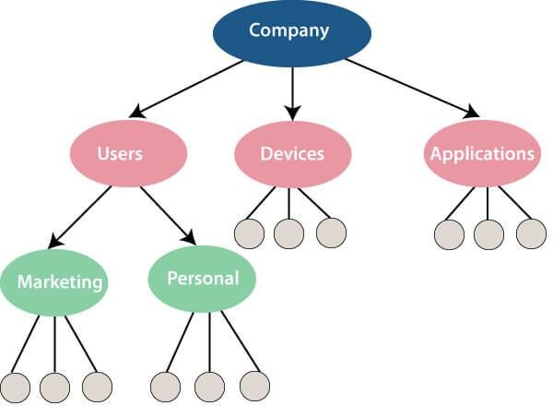

The Evolution : Hierarchical Data Model (1968-1980)
Prominent hierarchical database model was IBM's first DBMS.
It was called IMS (Information Management
System).
In this model, files are related in a parent/child manner.
Small circle represents objects.
Like file system, this model also had some limitations like complex implementation, lack structural independence, can't easily handle a many- many relationship, etc.

Slide 8

Charles Bachman developed the first DBMS at Honeywell called Integrated Data Store (IDS).
It was developed in the early 1960s, but it was standardized in 1971 by the CODASYL group (Conference on Data Systems Languages).
In this model, files are related as owners and members, like to the common network model.
Network data model identified the following
components:
The Evolution : Network data model
Network schema (Database organization)
Sub-schema (views of database per user)
Data management language (procedural)
This model also had some limitations like system
complexity and difficult to design and maintain.

Slide 9
It is the era of Relational Database and Database
Management.
In 1970, the relational model was proposed by E.F. Codd.
Relational database model has two main
terminologies called instance and schema.
The Evolution : Relational Database (1970 – Present)
The instance is a table with rows or columns
Schema specifies the structure like name of the relation, type of each column and name.
This model uses some mathematical concept like set
theory and predicate logic.
The first internet database application had been created in 1995.
During the era of the relational database, many more models had introduced like object-oriented model, object-relational model, etc.

Slide 10


The Evolution : Cloud database
Cloud database facilitates you to store, manage, and retrieve their structured, unstructured data via a cloud platform.
This data is accessible over the Internet.
Cloud databases are also called a database as service (DBaaS) because they are offered as a managed service.
Some best cloud options are:
AWS (Amazon Web Services)
Snowflake Computing
Oracle Database Cloud Services
Microsoft SQL server
Google cloud spanner

Slide 11
The Evolution : Cloud database (Advantages)
Lower costs: Generally, company provider does not have to invest in databases. It can maintain and support one or more data centers.
Automated: Cloud databases are enriched with a variety of automated processes such as recovery,
failover, and auto-scaling.
Increased Accessibility: You can access your cloud-based database from any location, anytime. All you need is just an internet connection.

Slide 12
A NoSQL (not only SQL) database is an approach to design such databases that can accommodate a wide variety of data models.
It is an alternative to traditional relational databases in which data is placed in tables, and data schema is perfectly designed before the database is built.
NoSQL databases are useful for a large set of
distributed data.
Some examples of NoSQL database system with their category are:
The Evolution : NoSQL Database
MongoDB, CouchDB, Cloudant (Document-
based)
Memcached, Redis, Coherence (key-value store)
HBase, Big Table, Accumulo (Tabular)

Slide 13



High Scalability:
NoSQL can handle an extensive amount of data because of scalability. If the data grows, NoSQL database scale it to handle that data in an efficient manner.
High Availability:
NoSQL supports auto replication. Auto replication makes it highly available because, in case of any failure, data replicates itself to the previous consistent state.
The Evolution : NoSQL Database (Advantage)

Slide 14
Open source:
NoSQL is an open-source database, so there is no reliable standard for NoSQL yet.
Management challenge:
Data management in NoSQL is much more complicated than relational databases. It is very challenging to install and even more hectic to manage daily.
The Evolution :
NoSQL Database (Disadvantage)
GUI is not available:
GUI tools for NoSQL database are not easily available in the market.
Backup:
Backup is a great weak point for NoSQL databases. Some databases, like MongoDB, have no powerful approaches for data backup.

Slide 15
The object-oriented databases contain data in the form of object and classes.
Objects are the real-world entity, and types are the collection
of objects.
An object-oriented database is a combination of relational model features with objects-oriented principles.
It is an alternative implementation to that of the relational
model.
Object-oriented databases hold the rules of object-oriented programming.
An object-oriented database management system is a hybrid
application.
The Evolution : The Object-Oriented Databases

Slide 16
The Evolution : The Object-Oriented Databases (Properties)
Object-oriented programming
Objects
Classes
Inheritance
Polymorphism
Encapsulation
Relational database
Atomicity
Consistency
Integrity
Durability
Concurrency
Query processing

Slide 17


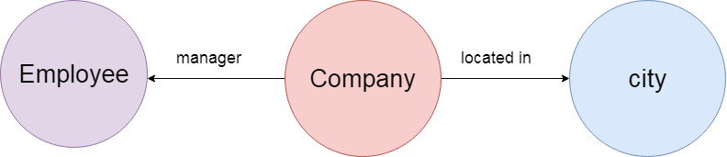
The Evolution : Graph Databases
A graph database is a NoSQL database. It is a graphical representation of data. It contains nodes and edges. A node represents an entity, and each edge represents a relationship between two edges. Every node in a graph database represents a unique identifier.
Graph databases are beneficial for searching the relationship between data because they highlight the relationship between relevant data.
Graph databases are very useful when the database contains a complex relationship and dynamic schema.
It is mostly used in supply chain management, identifying the source of IP telephony.

Slide 18
The Evolution : DBMS
DataBase Management System is software which is used to store and retrieve the database.
For example, Oracle, MySQL, etc.; these are some popular DBMS tools.
DBMS provides the interface to perform the various operations like creation, deletion,
modification, etc.
DBMS allows the user to create their databases as per their requirement.
DBMS accepts the request from the application and provides specific data through the operating
system.
DBMS contains the group of programs which acts according to the user instruction.
It provides security to the database.

Slide 19



Controls redundancy:
It stores all the data in a single database file, so it can control data redundancy.
Data sharing:
Advantage of DBMS
An authorized user can share the data among multiple users.
Backup:
It provides Backup and recovery subsystem. This recovery system creates automatic data from system failure and restores data if required.
Multiple user interfaces:
It provides a different type of user interfaces like GUI, application interfaces.

Slide 20
Size:
It occupies large disk space and large memory to run efficiently.
Disadvantage of DBMS
Cost:
DBMS requires a high-speed data processor and larger memory to run DBMS software, so it is costly.
Complexity:
DBMS creates additional complexity
and requirements.

Slide 21
The word RDBMS is termed as 'Relational Database Management System.' It is represented as a table that contains rows and column.
RDBMS is based on the Relational model; it was introduced by E. F. Codd.
A relational database contains the following components:
The Evolution : RDBMS
Table
Record/ Tuple
Field/Column name /Attribute
Instance
Schema
Keys
An RDBMS is a tabular DBMS that maintains the security, integrity, accuracy, and consistency of the data.

